Slide 1

Social History
of Organized Crime in Canada
PROF. ANTONIO NICASO

Slide 2
Organized Crime in Canada
Over 2,600 organized crime groups are operating in Canada. They continue to contribute to the increasing number of fentanyl-related deaths, methamphetamine addiction, and firearms related violence.
There are common patterns among high-threat OCGs networks, such as outlaw motorcycle gangs and mafia-related ones. These include:

Slide 3
Using violence as an integral part of their strategy.
Infiltrating law enforcement, security, government agencies and the private sector.
Extensive criminal associations to other OCGs, and
Having an interprovincial and international scope.

Slide 4
Street gangs
Street gangs use social media to encourage violence. They are also involved in most OCG-related public shootings and open acts of violence, putting innocent bystanders at risk.
OCGs move beyond their traditional bases of operations as they fight for control of distribution territories, which increases interprovincial violence.

Slide 5
Opioid crisis
There has been a rapid increase in OCGs involved in the opioid crisis. Their involvement includes the introduction of some emerging higher-risk opioids, such as:
Isotonitazene, more potent than fentanyl.
Black/Grey Death, a compound of heroin, fentanyl analogues, and other substances.
Xylazine, a sedative/analgesic in veterinary medicine that mimics the effects of opioids.

Slide 6
Non-traditional OCGs
Non-traditional OCGs also contribute to increased organized crime threats. These groups include cyber criminals, and those involved in money laundering.

Slide 7
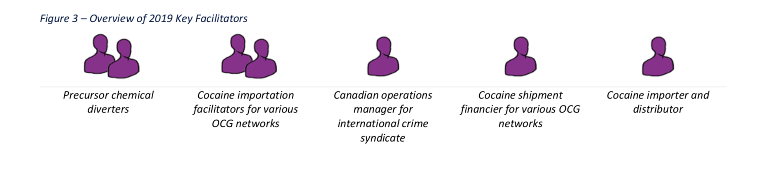
Facilitators

Slide 8
Money laundering
Most organized crime groups and other criminals disguise their proceeds of crime. Law enforcement has identified 176 OCGs reported to be involved in money laundering operations.
Approximately 50% of the 176 Canadian organized crime groups involved with money laundering maintain international links. Almost half of the groups with international relations are engaged in the cocaine market.

Slide 9
Money laundering
Criminals commonly use cryptocurrencies to pay for mass-marketing fraud and dark web marketplace purchases. They’re also an attractive tool for laundering proceeds of crime.

Slide 10
Fraud
On line scams are becoming increasingly common and have significantly risen during the pandemic.

Slide 11
Fraud
Some fraudulent schemes collect sensitive personal information in addition to money. Some examples:
Government services schemes, Identity theft and phishing, Romance scams, Ransomware schemes, Elder-targeted scams, Securities fraud, Payments card fraud, Real Estate fraud.

Slide 12
Fraud
Many victims are embarrassed and don’t report it.
Financial crime, often seen as a “white collar” crime, is committed by competent criminals and interconnected OCGs, in Canada and abroad.
Some Canadian OCGs are directly involved in running boiler rooms (telemarketing centres used in fraud). Others collect a portion of the profits. They use the profit to fund other criminal activities, like importing and trafficking drugs.

Slide 13
Players
The Criminal Intelligence Service of Canada assessed 14 OCGs as national High-Level Threats. They have interprovincial networks, if not always international connections, engage in multiple criminal markets, use violence to further their illegal business, and have a large number of criminal OCG association links.

Slide 14
Five High-Level Threats are involved in some of the most massive cocaine importing networks in Canada, which leverage ties to Mexican and Colombian drug trafficking organizations, such as the Sinaloa Cartel, to import up to 1000 kilograms of cocaine per month.
Land or marine modes are believed to be used to introduce narcotics via the United States, or through Mexico, the Dominican Republic, and Colombia. These networks are often highly-entrenched, use multiple cocaine importation facilitators, and have extensive international criminal connections throughout Latin and Central America that likely facilitate cocaine importations into Canada and overseas to destinations such as Italy, Australia, and New Zealand.

Slide 15
An equal number of High-Level Threats are also involved in large methamphetamine networks. Their activities include
importation of precursor chemicals from China for the domestic production of methamphetamine,
diverting unregulated chemicals in Canada to local clan labs, and,
importing amphetamine or precursors from sources in Mexico.
Several of these groups are also involved in money laundering as a primary criminal activity or maintain associations with professional money laundering service providers with extensive ties to South East Asia. They are allegedly associated with Triads based in China.

Slide 16
At least four High-Level Threats are linked to money launderers for large international organized crime networks, providing laundering services for domestic and international drug traffickers.
Many of these groups have links to Mexican cartels, are suspected of importing synthetic drugs and cocaine and being involved in illegal gaming, and are included in the international movement of bulk cash and loan sharking.

Slide 17
Many of the High-Level Threats are involved in violence, with members suspected of being involved in homicides, shootings, and assaults.
Younger bosses, especially from Mexico, are gaining power and attempting to increase their influence in Canada.

Slide 18
Geographical scope
More than half of all assessed OCGs are involved in multi-jurisdictional criminal activities. Twenty-six percent of these OCGs have an illegal international scope, and another 28 percent have an interprovincial one.
OCGs operating in Canada are known or suspected of having international associations in 72 countries.

Slide 19
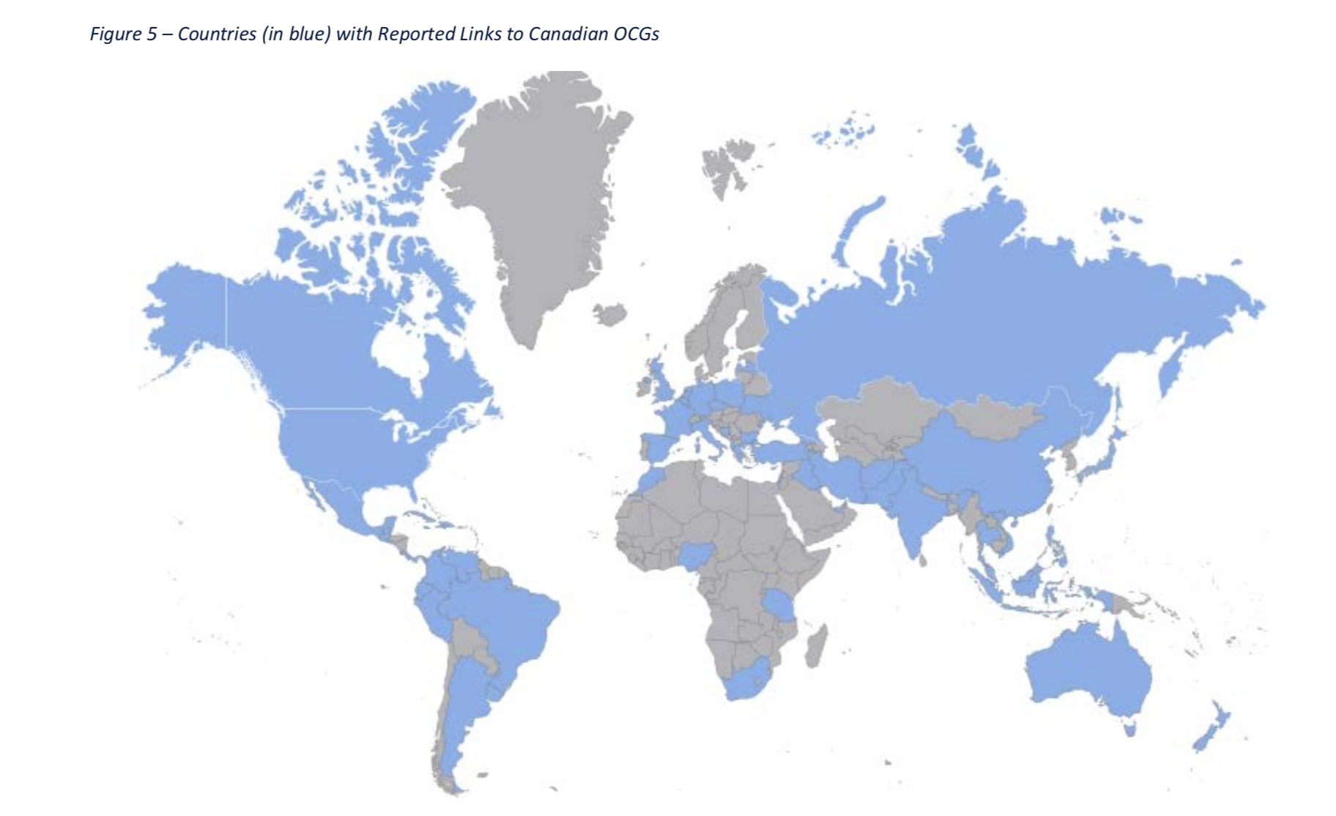

Slide 20
Of all OCGs, outlaw motorcycle gangs (OMGs) maintain the broadest international scope.
One OMG global network comprises more than 500 chapters in 60 countries across Europe, North America, South America, Africa, Asia, and Oceania. Members of this OMG in Canada and their support clubs continue to travel extensively to the Caribbean, Europe, and Central/South America.
Some countries represent source and transit points for importing/exporting cocaine.

Slide 21
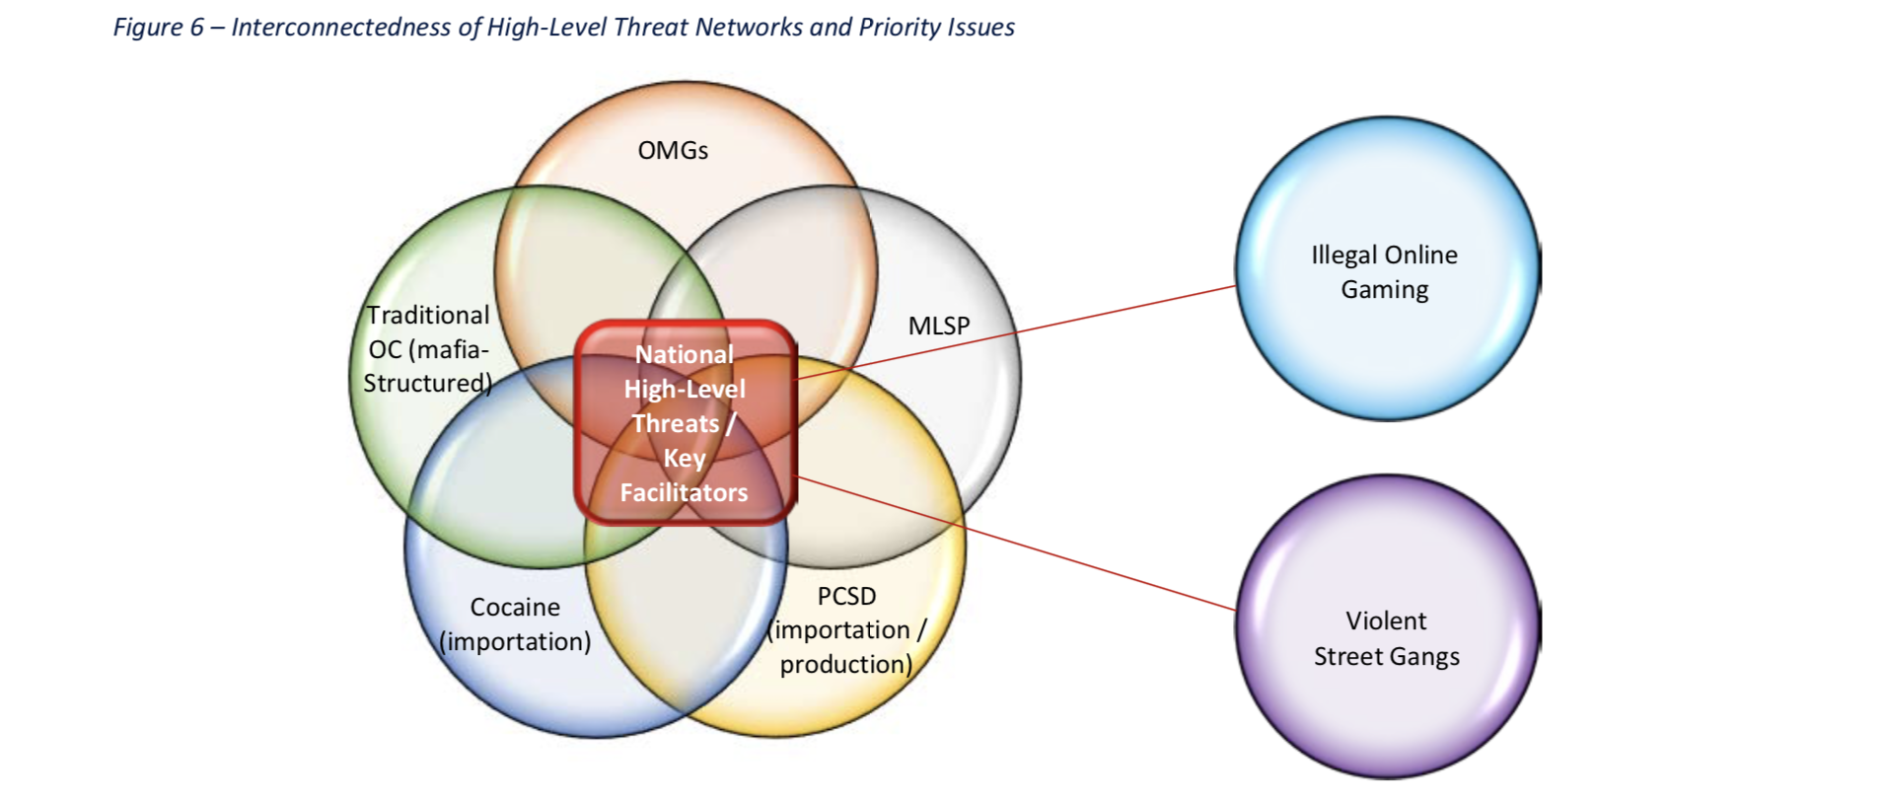
Network Assessment
PCSD: precursor chemicals and synthetic drugs (PCSD) – specifically those networks involved in the importation of precursors and the manufacture of methamphetamines and fentanyl.
MLSP: money laundering service provision

Slide 22
OMGs collaborate with other OCGs in importing cocaine and other illicit drugs and have networks stretching across Canada that facilitate their well-established distribution lines.
They are criminally associated with Traditional Organized Crime Groups. They are involved in illegal online gaming, a high-profit and low-risk market. While generally not part of the larger PCSD [precursor chemicals and synthetic drugs] networks, OMGs are involved in supplying and distributing synthetic drugs.
They are also closely associated with street gangs and leverage these associations to maintain/enforce their drug trafficking territories and outsource violence.

Slide 23
In addition to their links with OMGs, TOC groups are involved primarily in cocaine importation, illegal online gaming, and money laundering via multiple private sector businesses. They have domestic and international connections. The OCGs also use street gangs for homicides and attempted homicides of rivals.
OMGs and TOC often control importation networks and involve street gangs as part of their distribution channels.

Slide 24
Resources

Slide 25
Financial Resources
Extortion.
Prohibition (corruption).
Public contracts. Construction industry.
Drug trafficking.

Slide 26
Service providers
The criminals rationalize their participation in their criminal activities cleverly by simply describing themselves as “service providers” who only make available products to consensual parties who actively demand them.
Thomas Hobbes: people as inherently corruptible.

Slide 27
“I have defined organized crime as an integral part of the American social system that brings together a public that demands certain goods, and services that are defined as illegal, an organization of individuals who produce or supply those goods and services, and corrupt public officials who protect such individuals for their own profit or gain.”
–Francis Ianni (1974)

Slide 28
Money laundering
Some countries have become havens for money laundering. Canada, for instance, is desirable for money laundering activities, because of its lax laws in this area.
Another obstacle in eradicating money laundering is the fact that people do not think that it concerns them directly nor that it affects the general economy of the country.
Money laundering has become the oxygen of the underground economy and the legal economy.

Slide 29
Human capital
The term human capital is used in sociology and economic theory to refer to the skills, knowledge, and experience possessed by individuals or groups in organizational structures, measured in terms of their asset value or liability to them.

Slide 30
Human capital
Adam Smith: The talents of individuals in organizations are as valuable as the liquid (money) capital since it enhances the ability to increase capital income, which can then be reinvested propitiously.
Smith suggests that the appropriate division of labor, based on how capital is invested in people, is a crucial way to ensure success, given that it assigns skills in optimal ways.
The effective use of human capital is intrinsic to the operations of all the OCGs.

Slide 31
Social capital
In sociology and economic theory, the term social capital theory refers to the networks of relationships among people who work in a particular organization, enabling it to function effectively in terms of the specific kinds of interpersonal relations that people must establish to guarantee its smooth functioning.
In organized crime groups, social capital is critical - the gang’s survival rests on the interpersonal cooperation and bonding of all its members.

Slide 32
Bonding refers to the fact that social capital is created within a group with shared interests and goals.
Bridging is creating social capital across groups or entities outside the main group. This allows individuals within and outside the group to discover shared interests and goals and work together to achieve them.

Slide 33
Corruption
To ensure financial success, any corporation must create links outside of itself. In regular business, these are typically formal and above board.
In OCs, these involve one of the most important tactics that they employ to ensure that their sources of income remain stable and undetected - corruption.

Slide 34
Business Agenda
Extortion and racketeering
Drug trafficking and narcoterrorism
Transnational organized crime
The new crimes

Slide 35
Strategic violence
Strategic violence, not brutal force.
The grey zone
Revenge killing
Symbolic violence

